Slide 1

4th Meeting
Hook

Slide 2

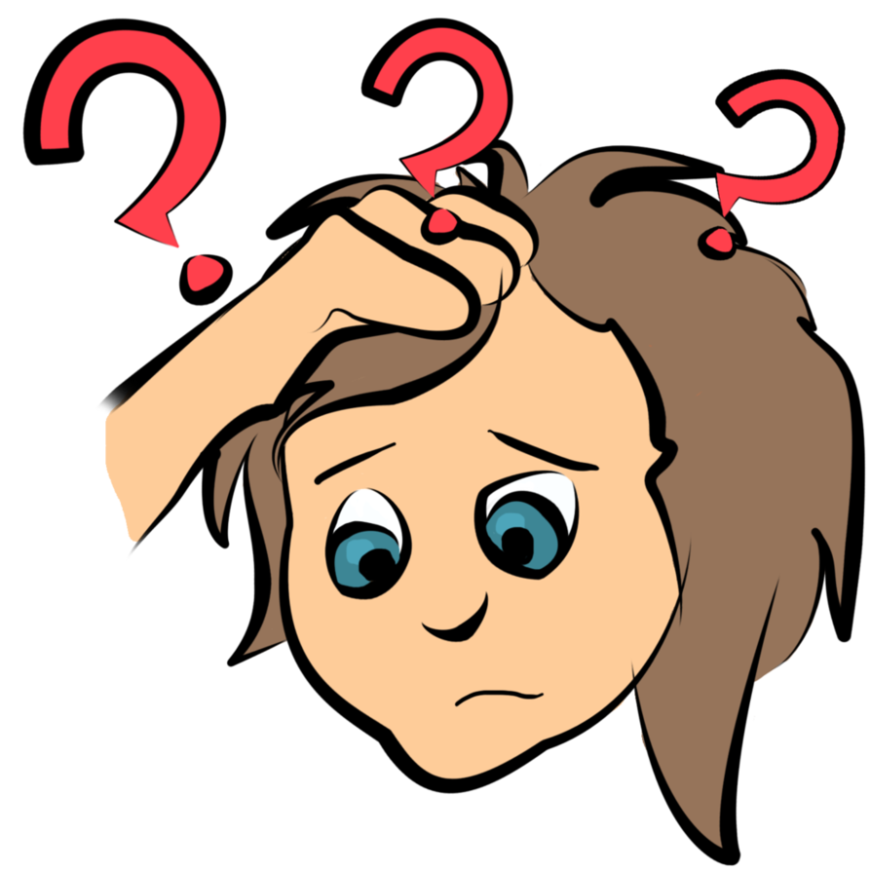
Why should we get The Audience’s Attention?
Because the more audience listens to you, the livelier your presentation will be!
It will also boost up your confidence!

Slide 3
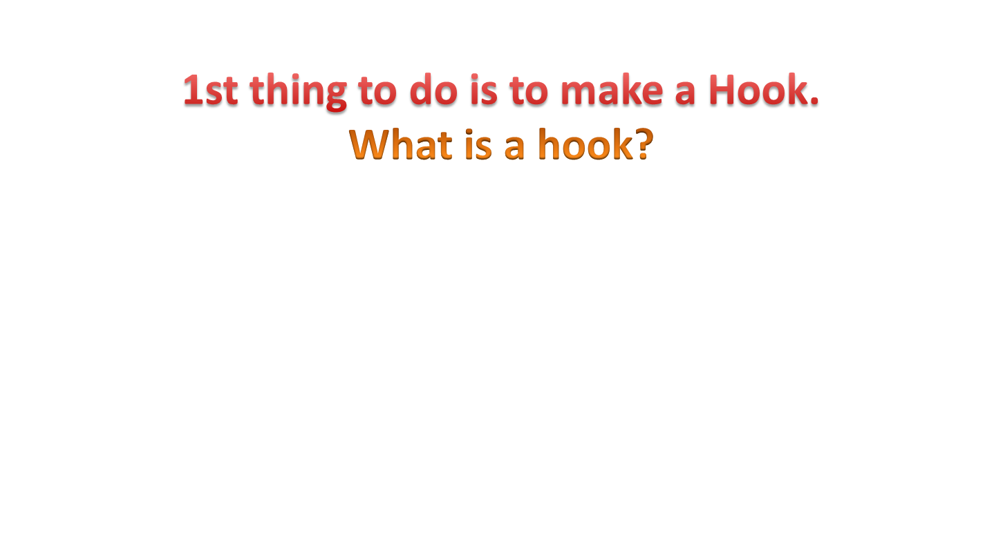

How can we grab audience’s attention?

Slide 4
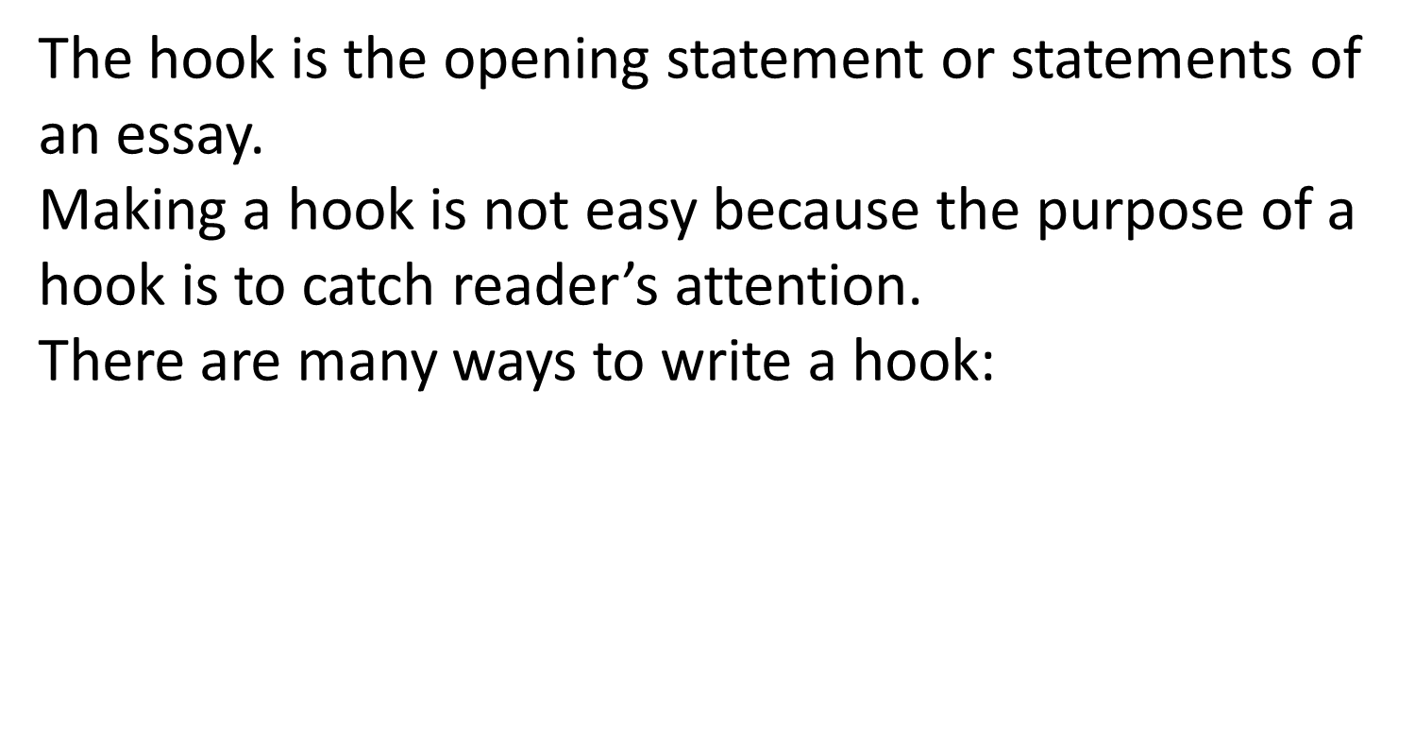
Hook

Slide 5

Hook
By asking a rhetorical question to your audience.
Ex. “How many people take medicine – even a simple aspirin – every day?”

Slide 6
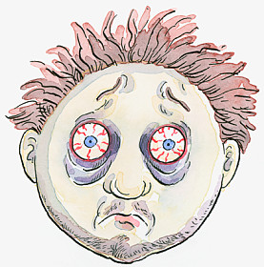
Hook
2) Use an interesting fact to make your audience curious.
Ex. “Asian economists are not sleeping well these days.” -----> Why? What’s the problem?

Slide 7

Hook
3) Use a narrative style about your own experience.
Ex. “When you wake up one day, suddenly your father/mother could not remember you. As you keep trying to explain about your name, he/she just stands there.” -----> Psychology/Biology presentation about dementia.

Slide 8

Hook
4) Begin with a famous quote.
Ex. “Children aren't coloring books. You don't get to fill them with your favorite colors.”
---> A quote from Khaled Hosseini.

Slide 9

Hook
5) Use a surprising or shocking statistic.
Ex. “Did you know that over 120 Indonesian people are dead every day on the road?”
-----> An essay about traffic accidents

Slide 10
Assignment (continue)
Choose one of the following topics and present your middle/content:
Culture
Popular Food or Drinks
Sports
Individual presentation
Time limit : max. 5 minutes
Don’t use powerpoint, animation, or anything. You may only bring a text and use a marker to write on the board.

Slide 11

Thank You !

